Slide 1


FPT SOFTWARE
Machine Learning Fundamentals
10/02/18

Slide 2
Supervised Learning
Lecture 2: Supervised Learning
Outline:
Classification, Regression
Inductive Learning
Decision Trees
Bayesian Learning
Neural Networks
Model Ensembles
Learning Theory
Support Vector Machine
Project Assignment

Slide 3
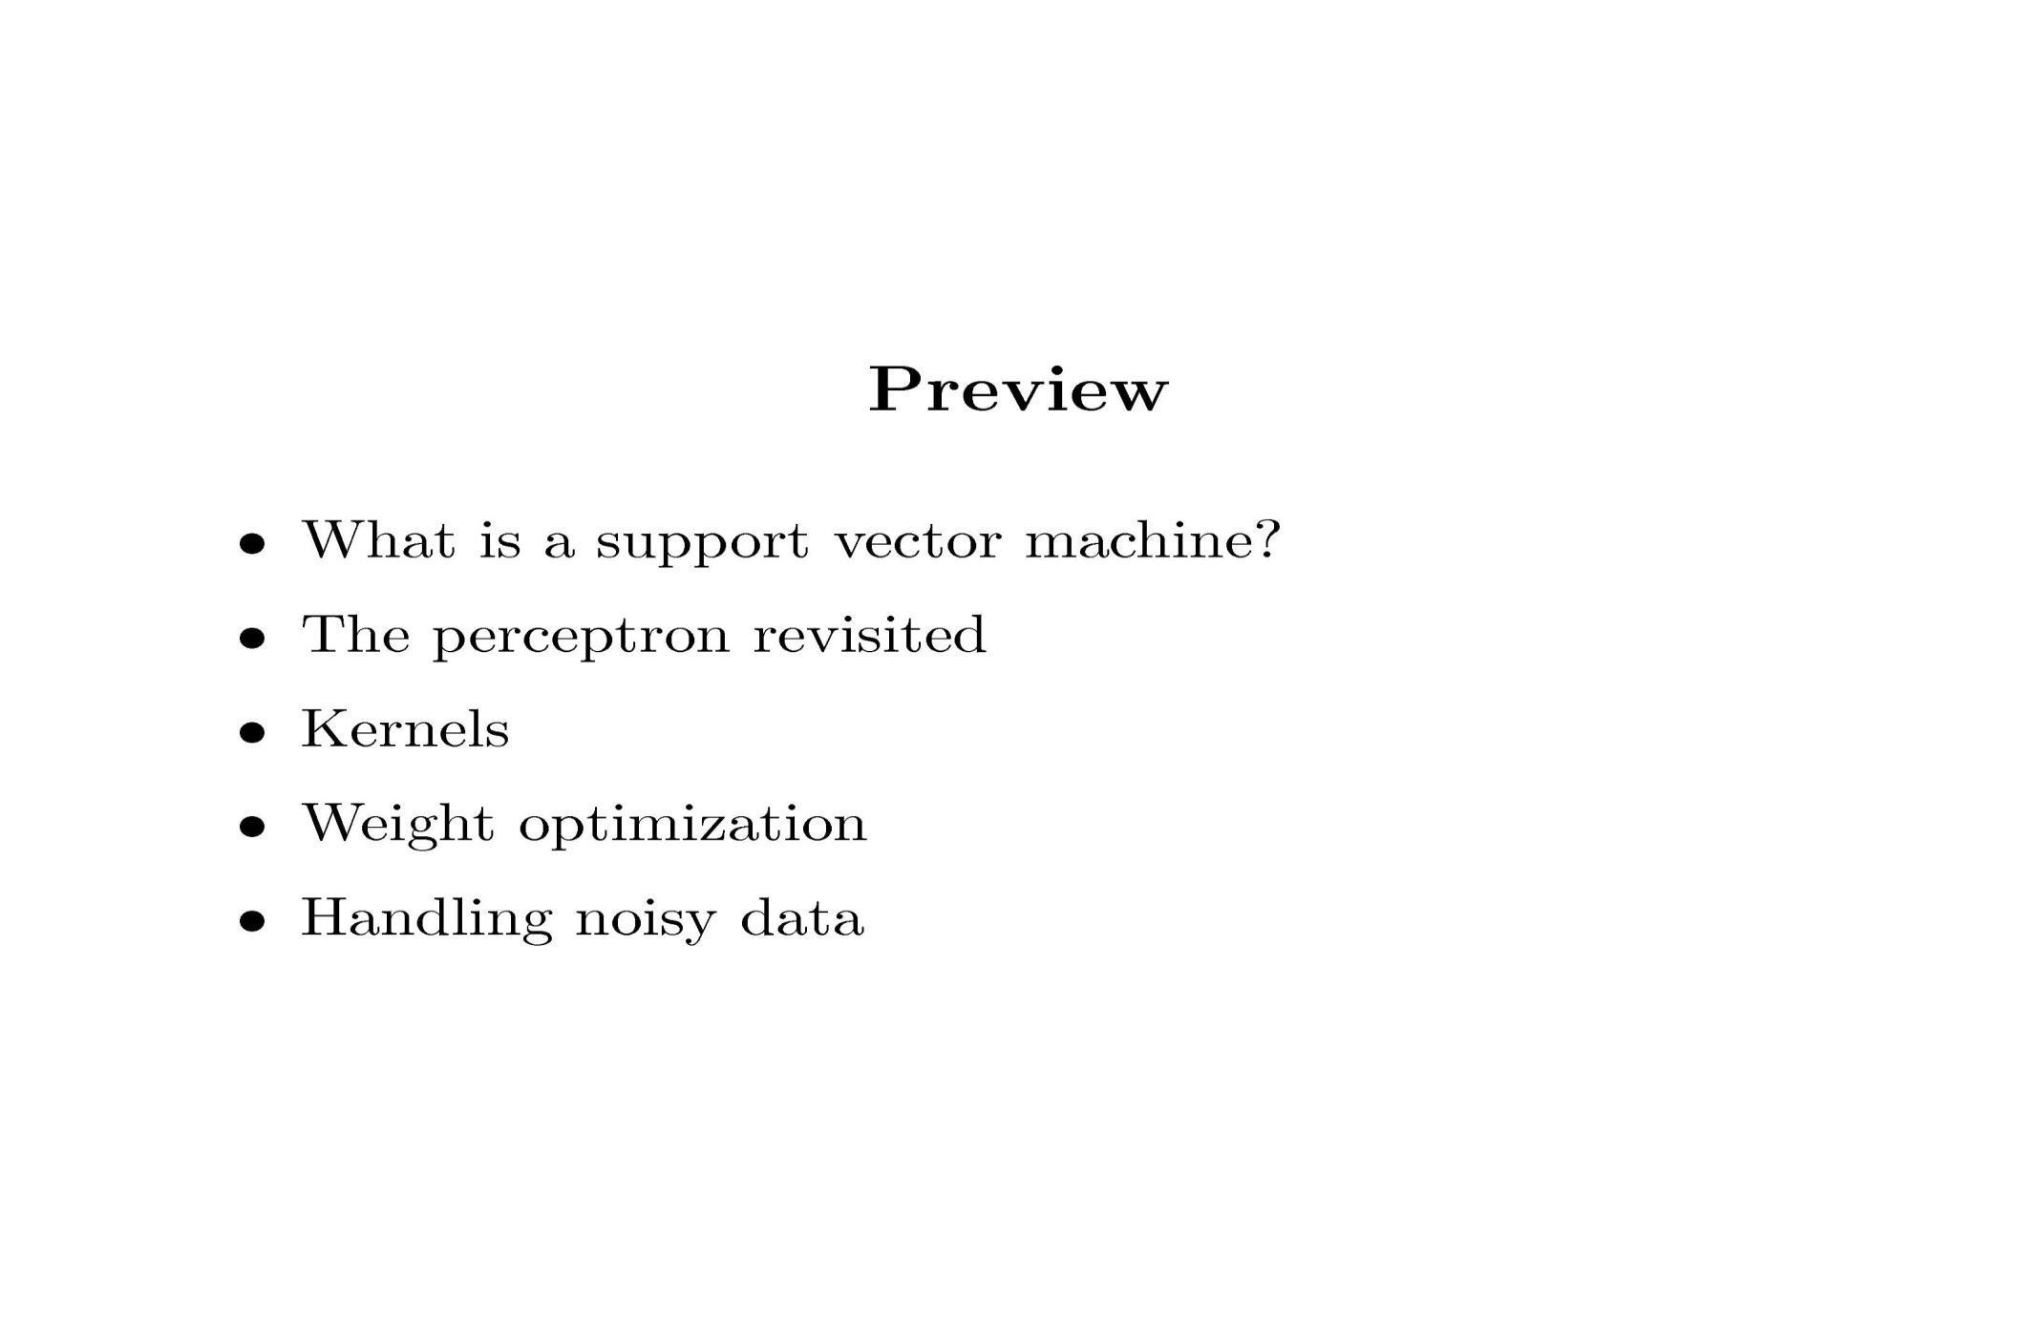
Support Vector Machine

Slide 4
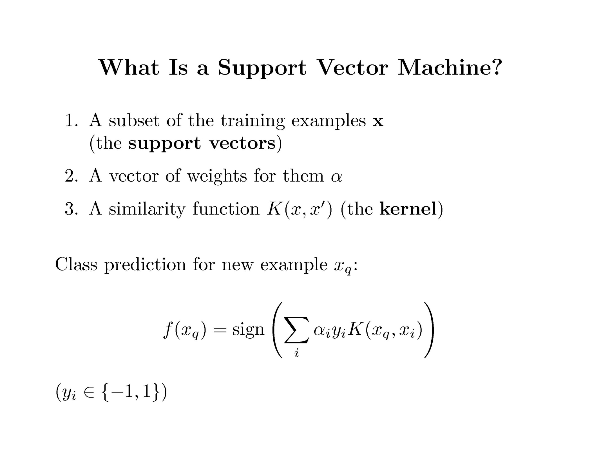
Support Vector Machine

Slide 5
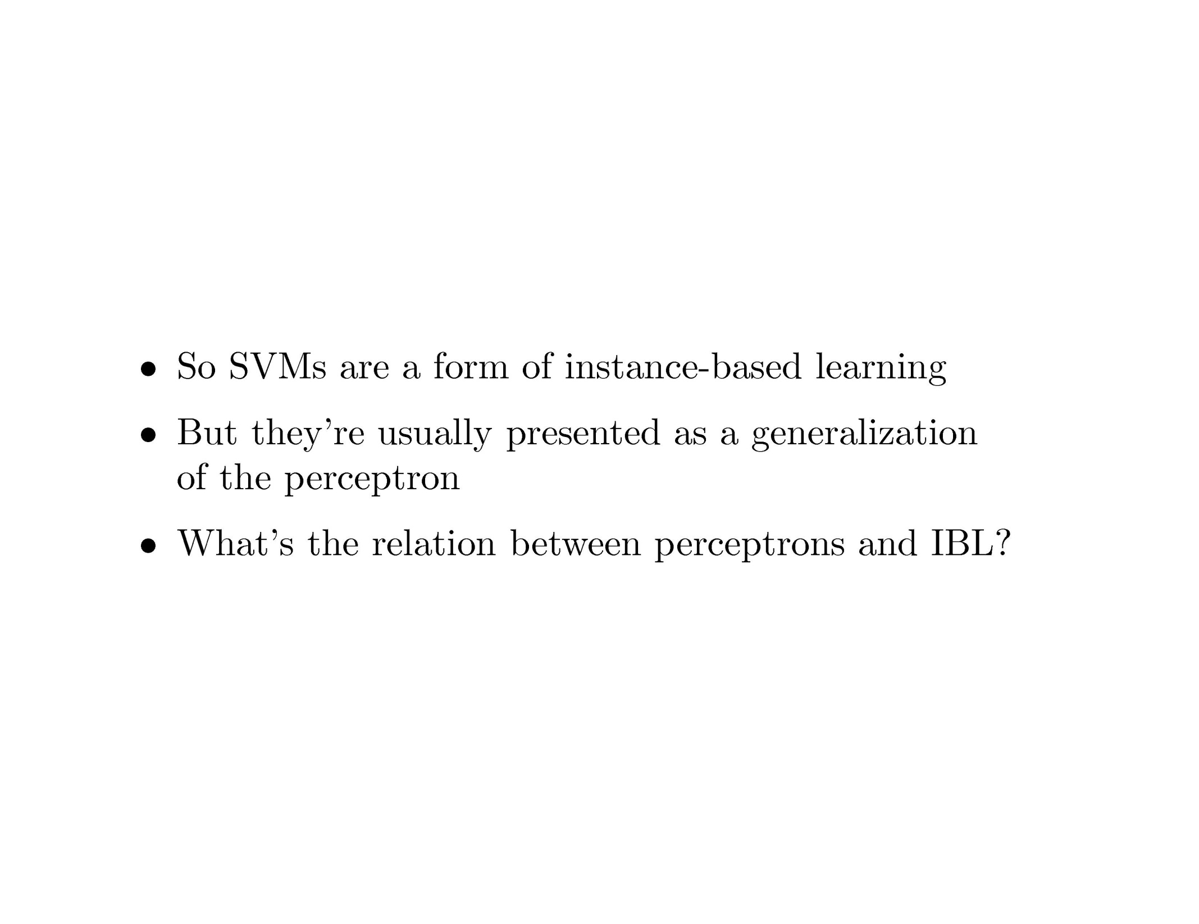
Support Vector Machine

Slide 6
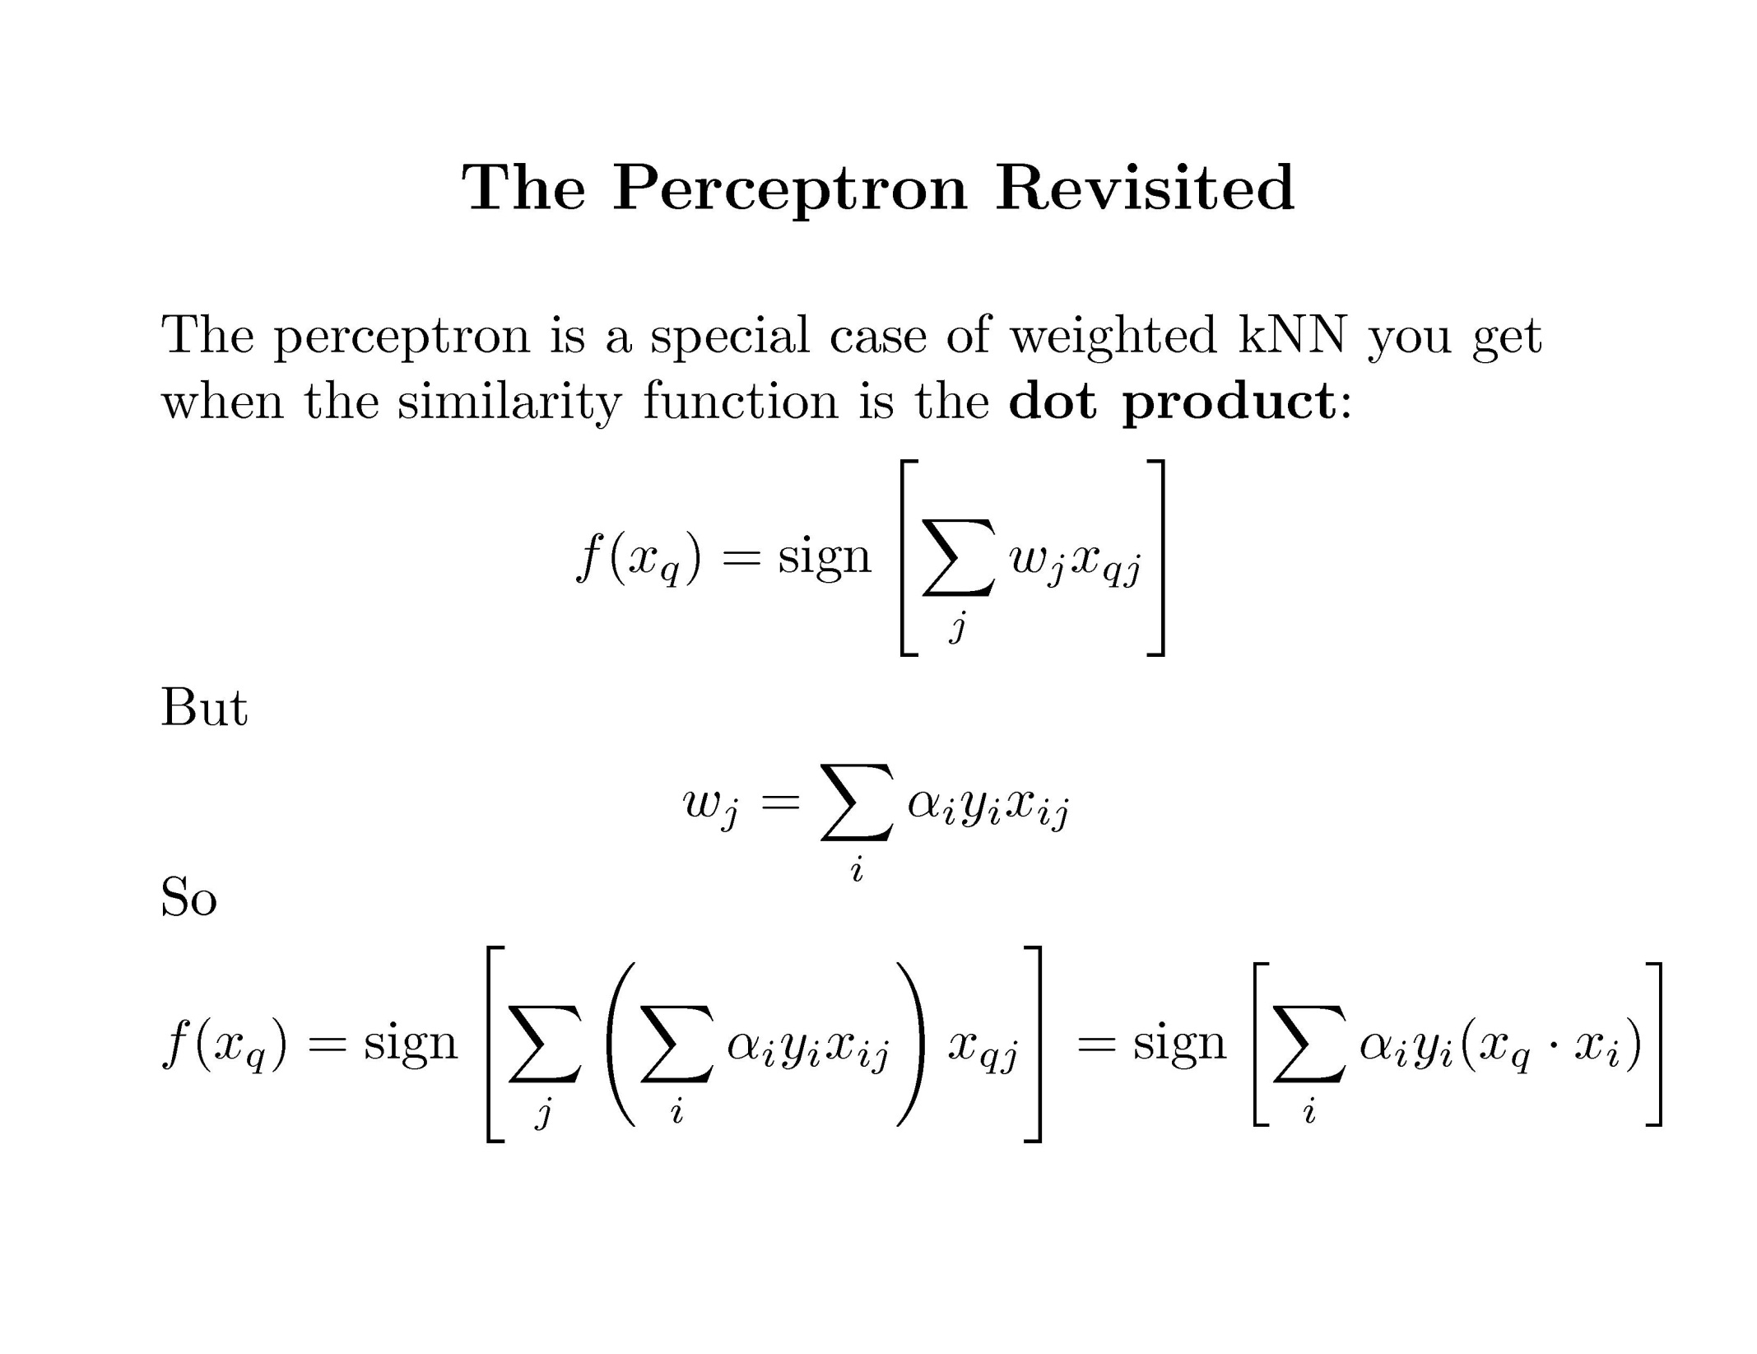
Support Vector Machine

Slide 7
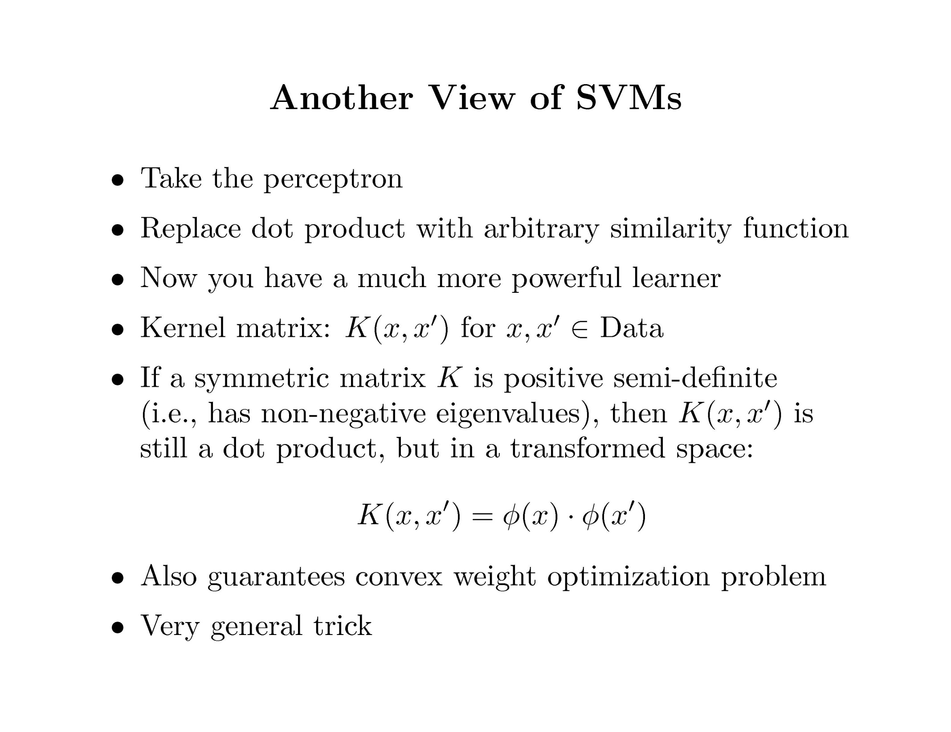
Support Vector Machine

Slide 8
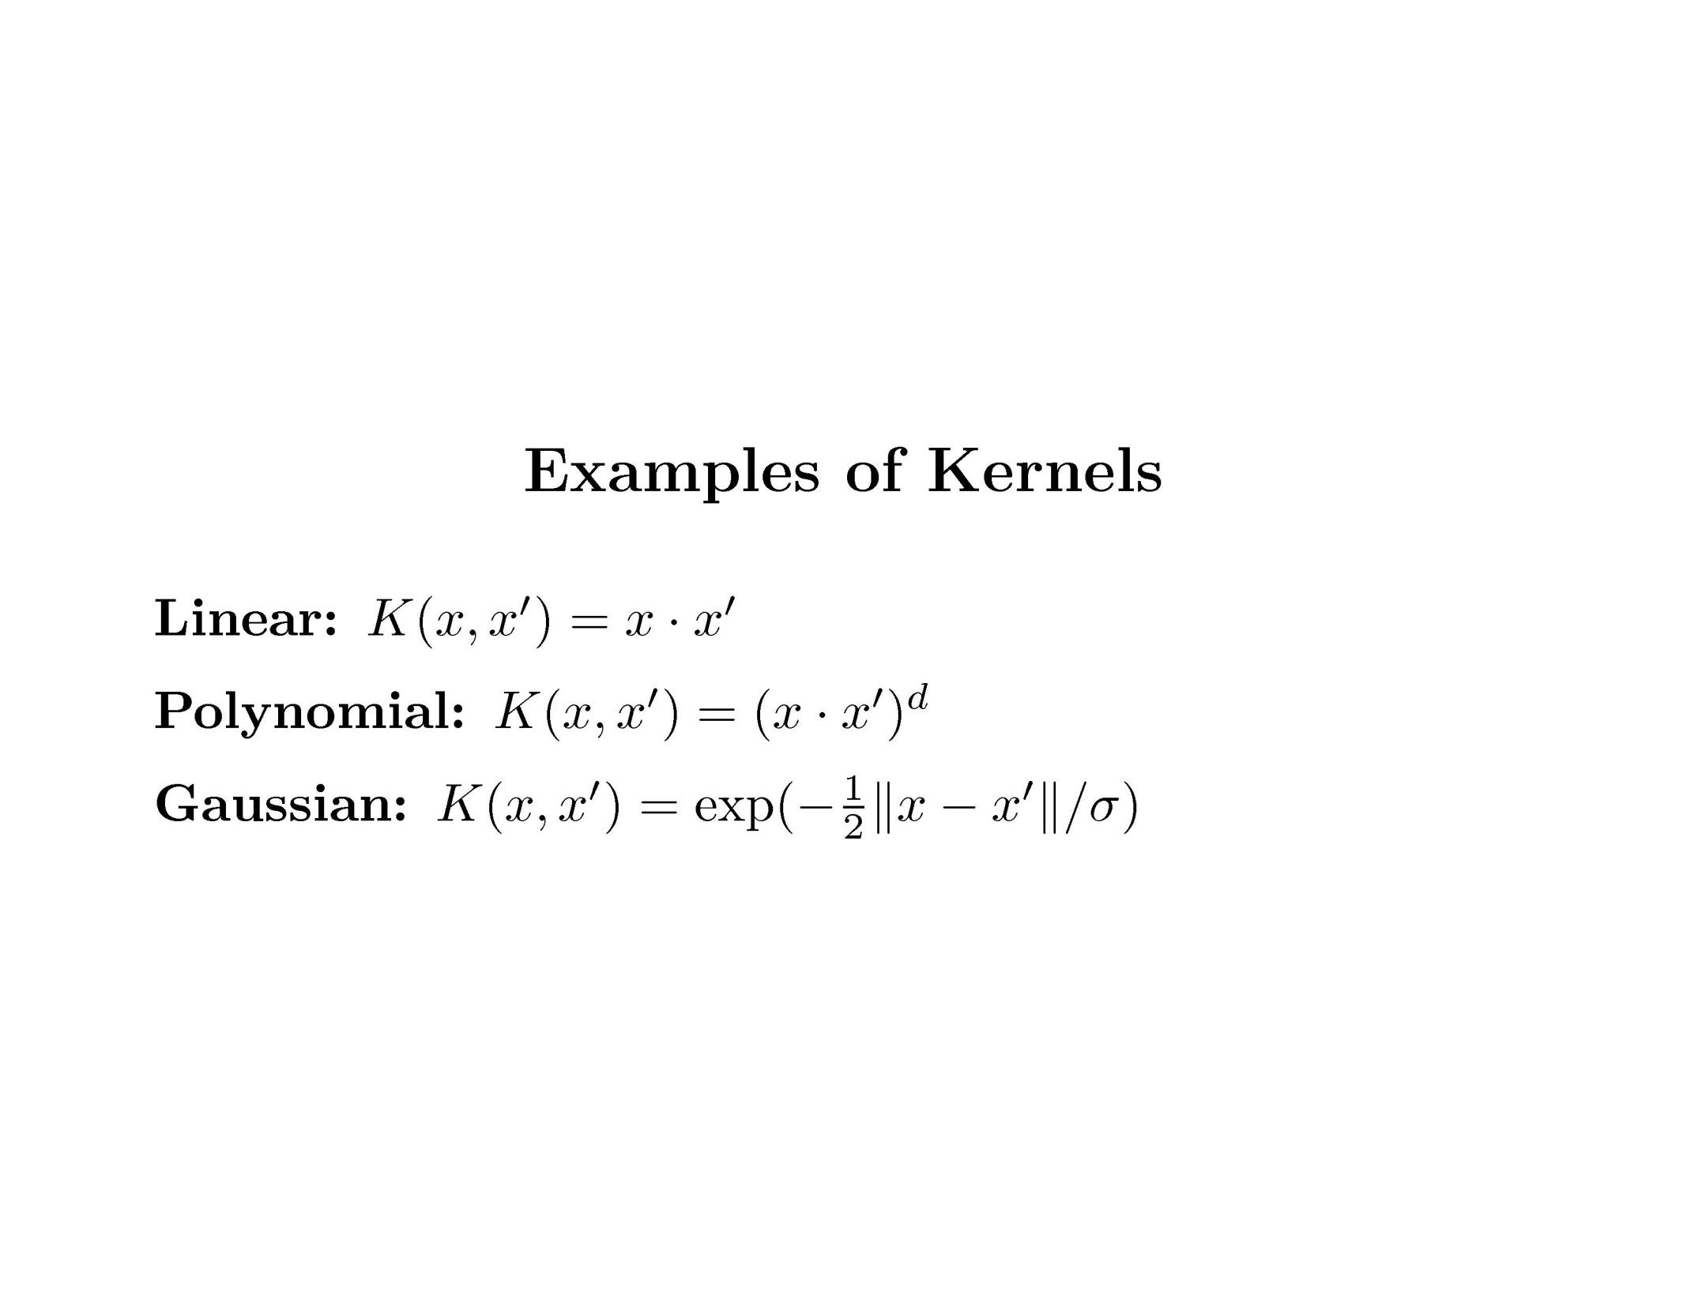
Support Vector Machine

Slide 9
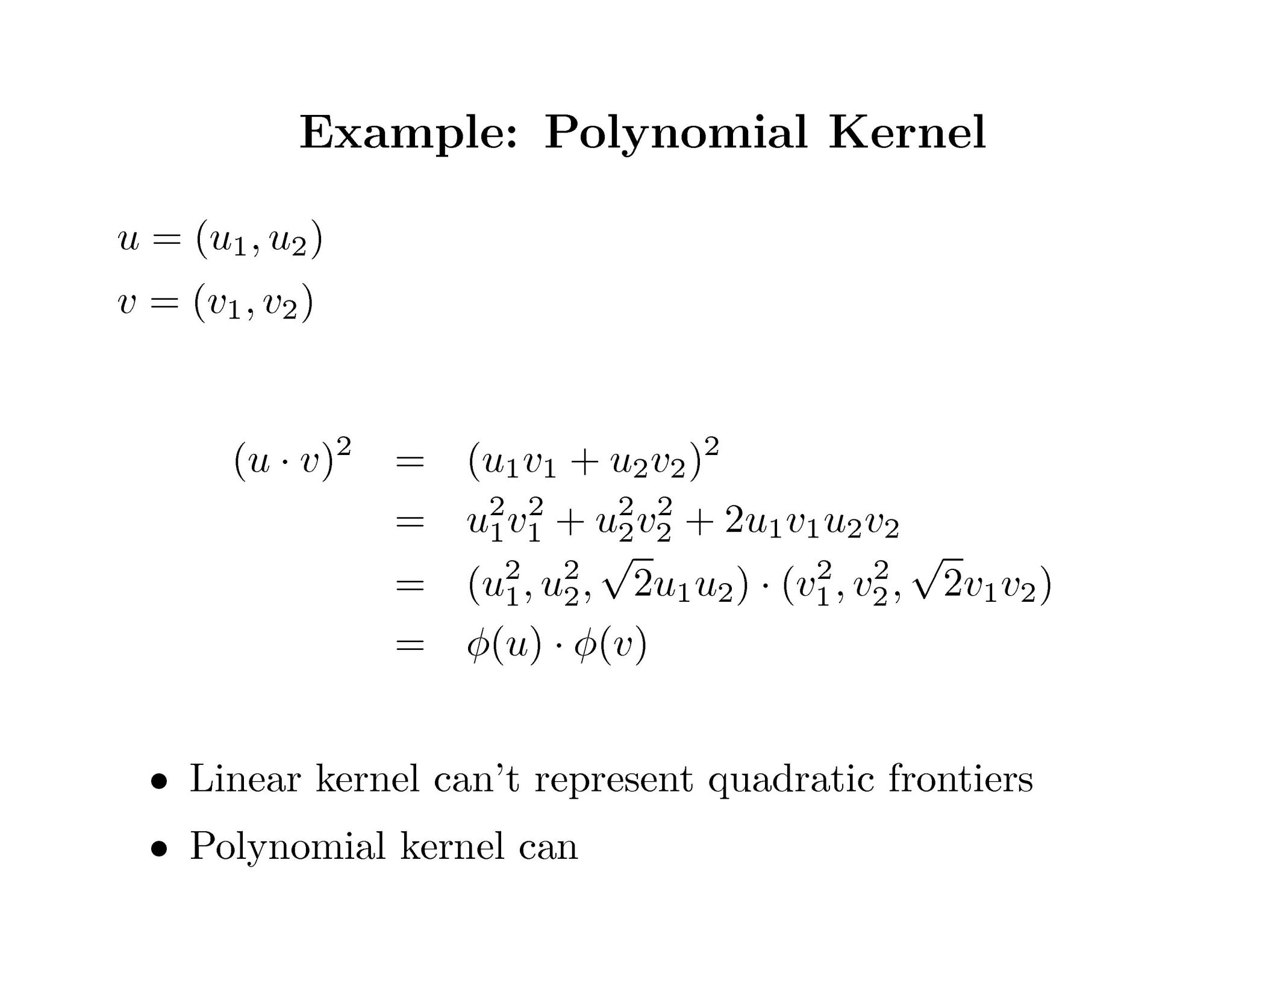
Support Vector Machine

Slide 10
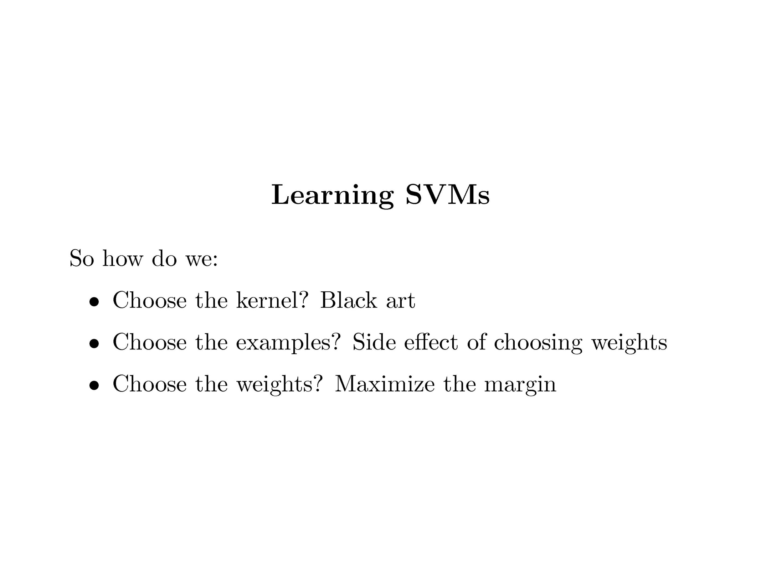
Support Vector Machine

Slide 11
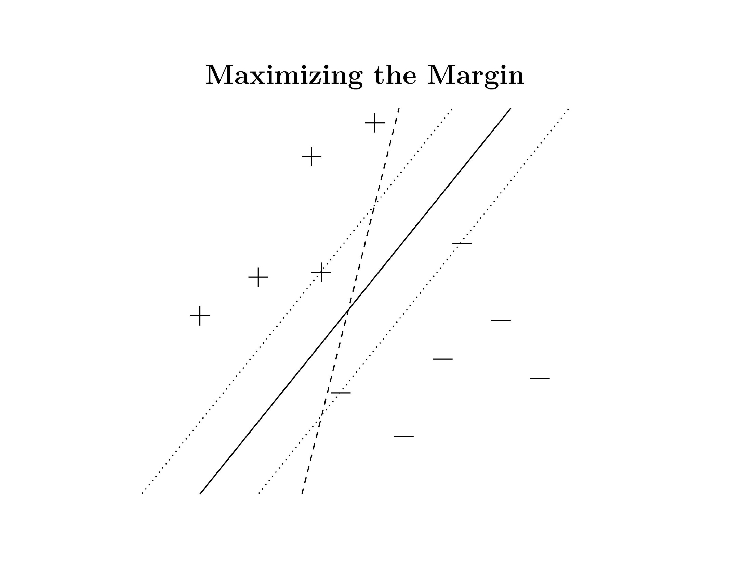
Support Vector Machine

Slide 12
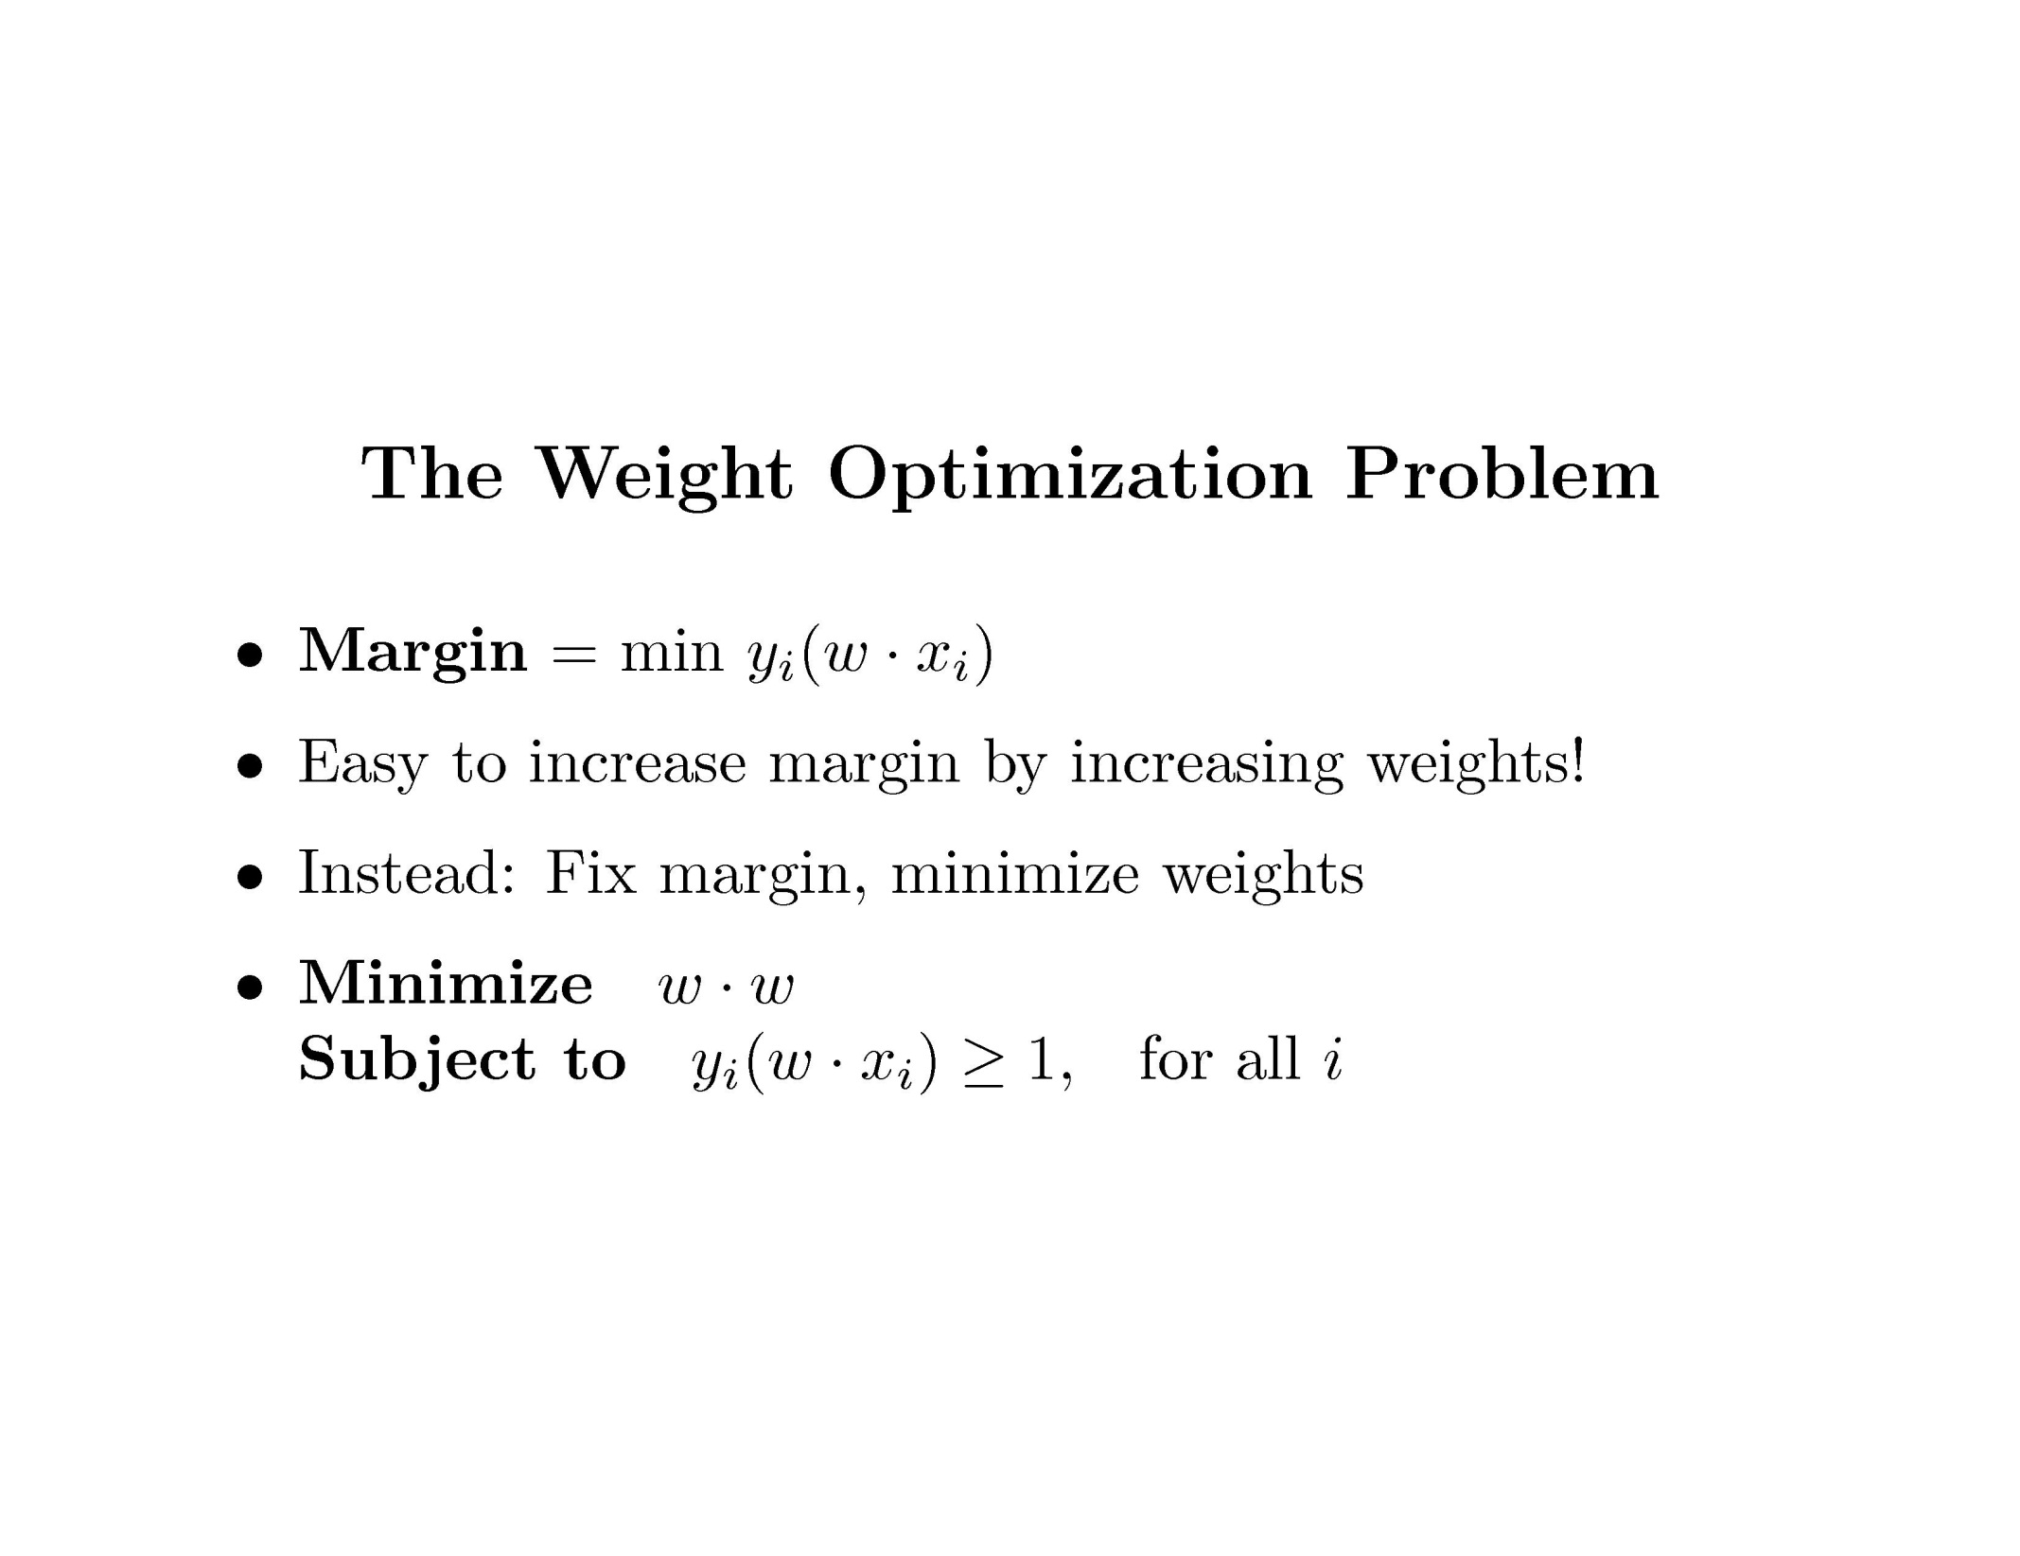
Support Vector Machine

Slide 13
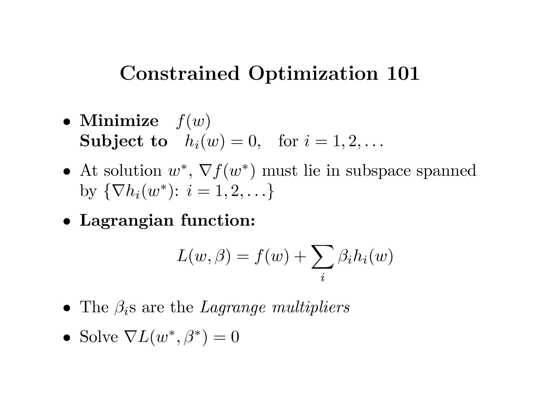
Support Vector Machine

Slide 14
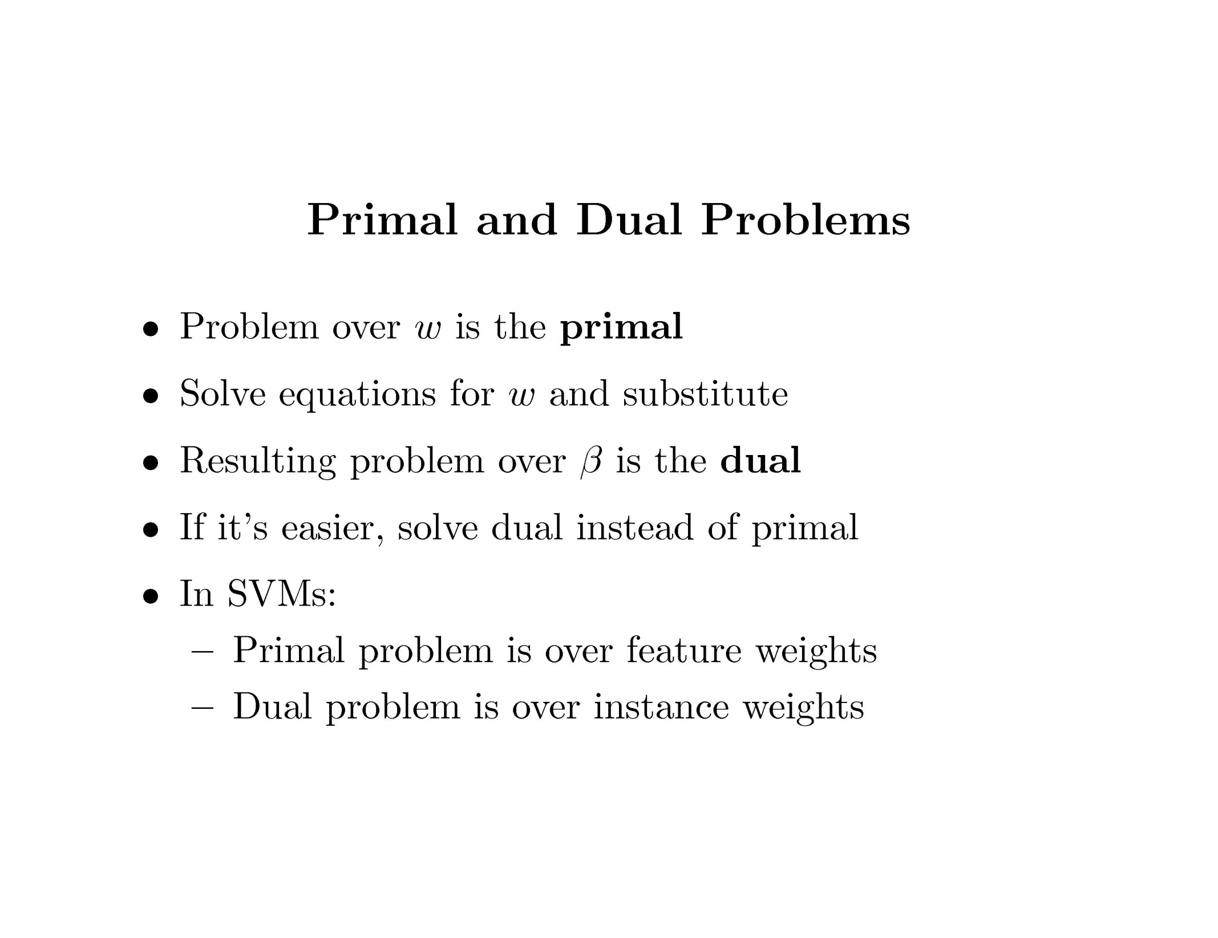
Support Vector Machine

Slide 15
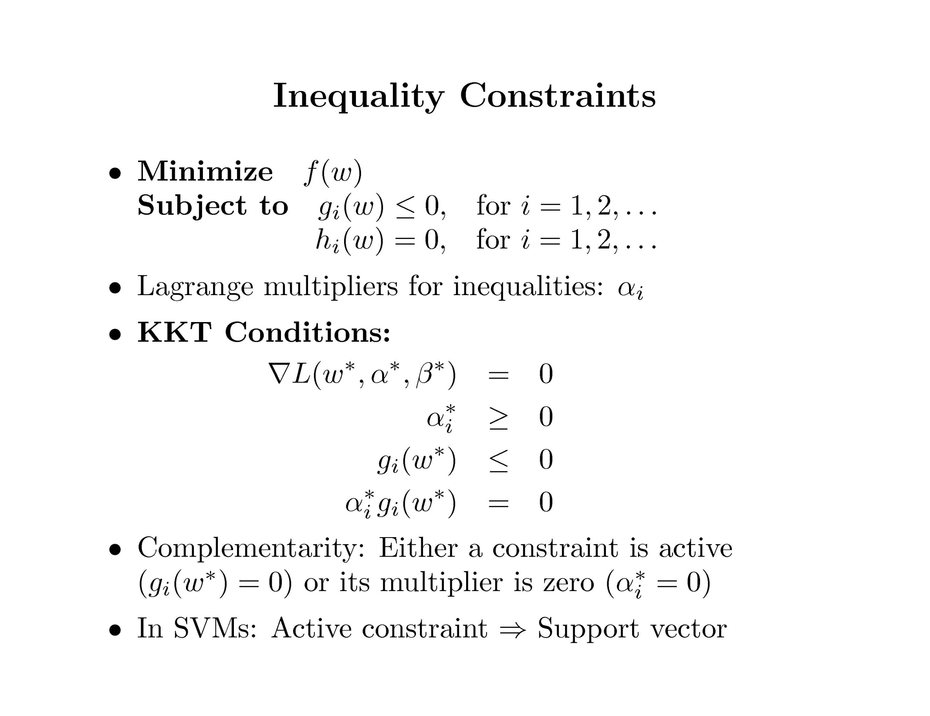
Support Vector Machine

Slide 16
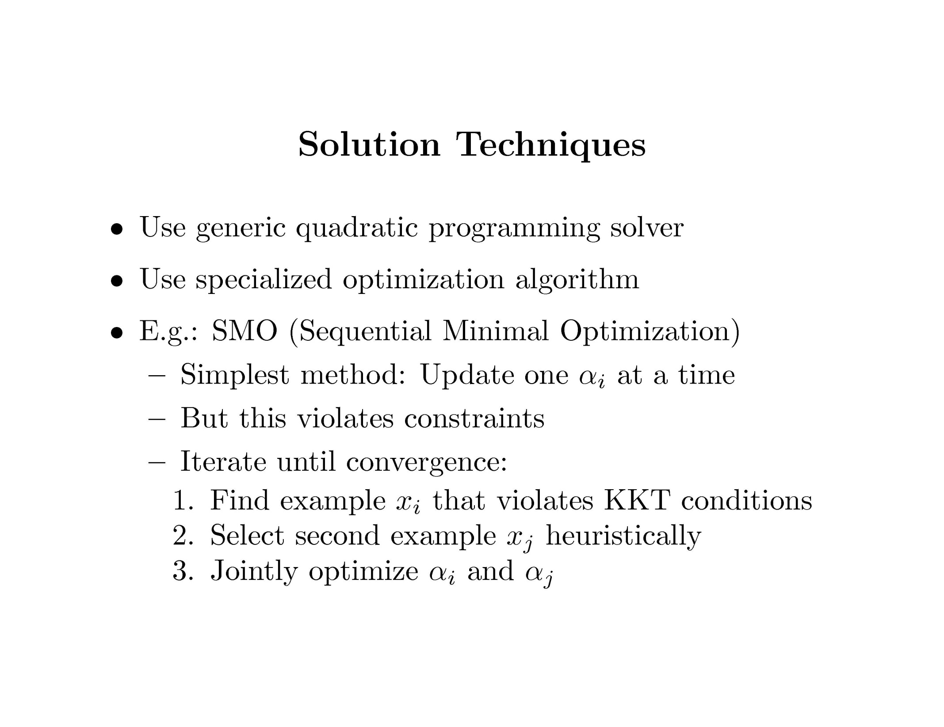
Support Vector Machine

Slide 17

Support Vector Machine

Slide 18
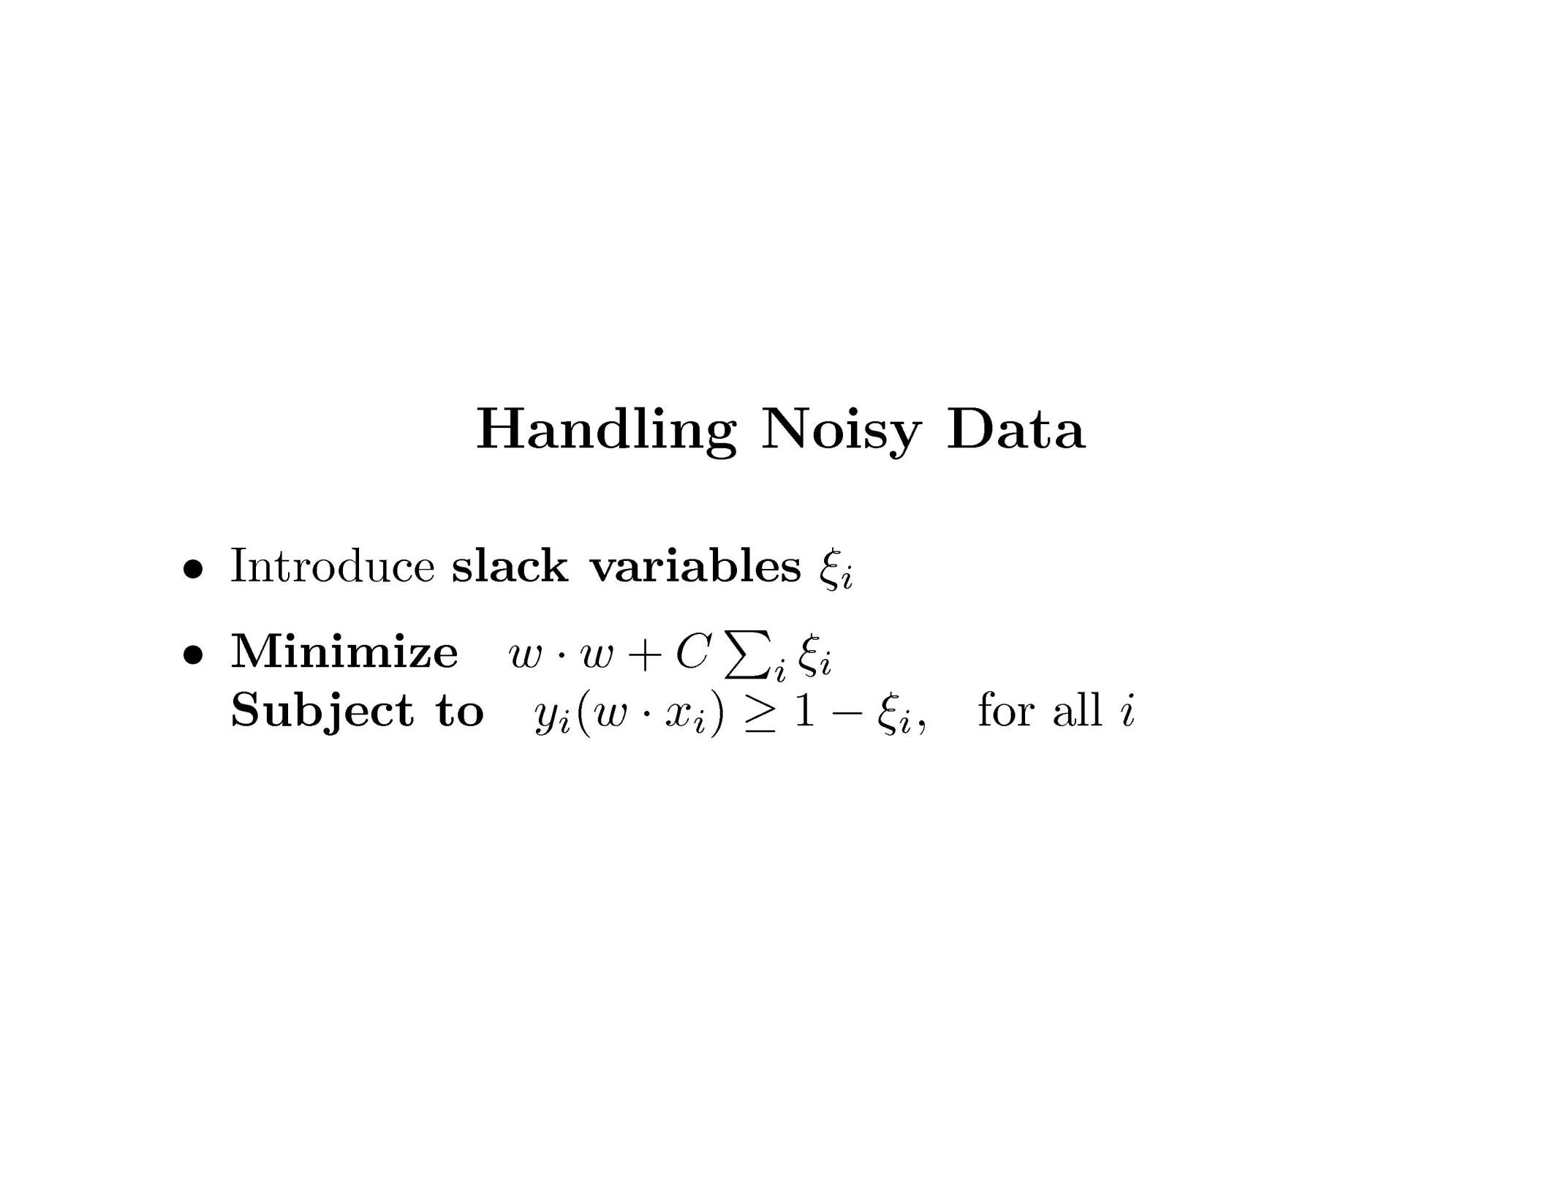
Support Vector Machine

Slide 19
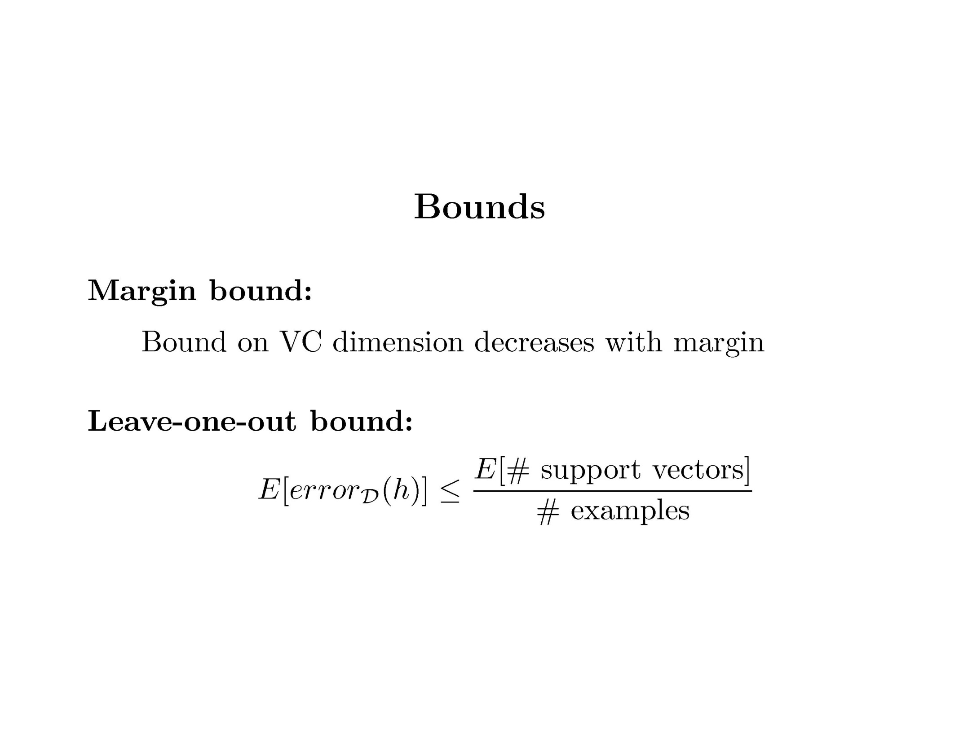
Support Vector Machine

Slide 20
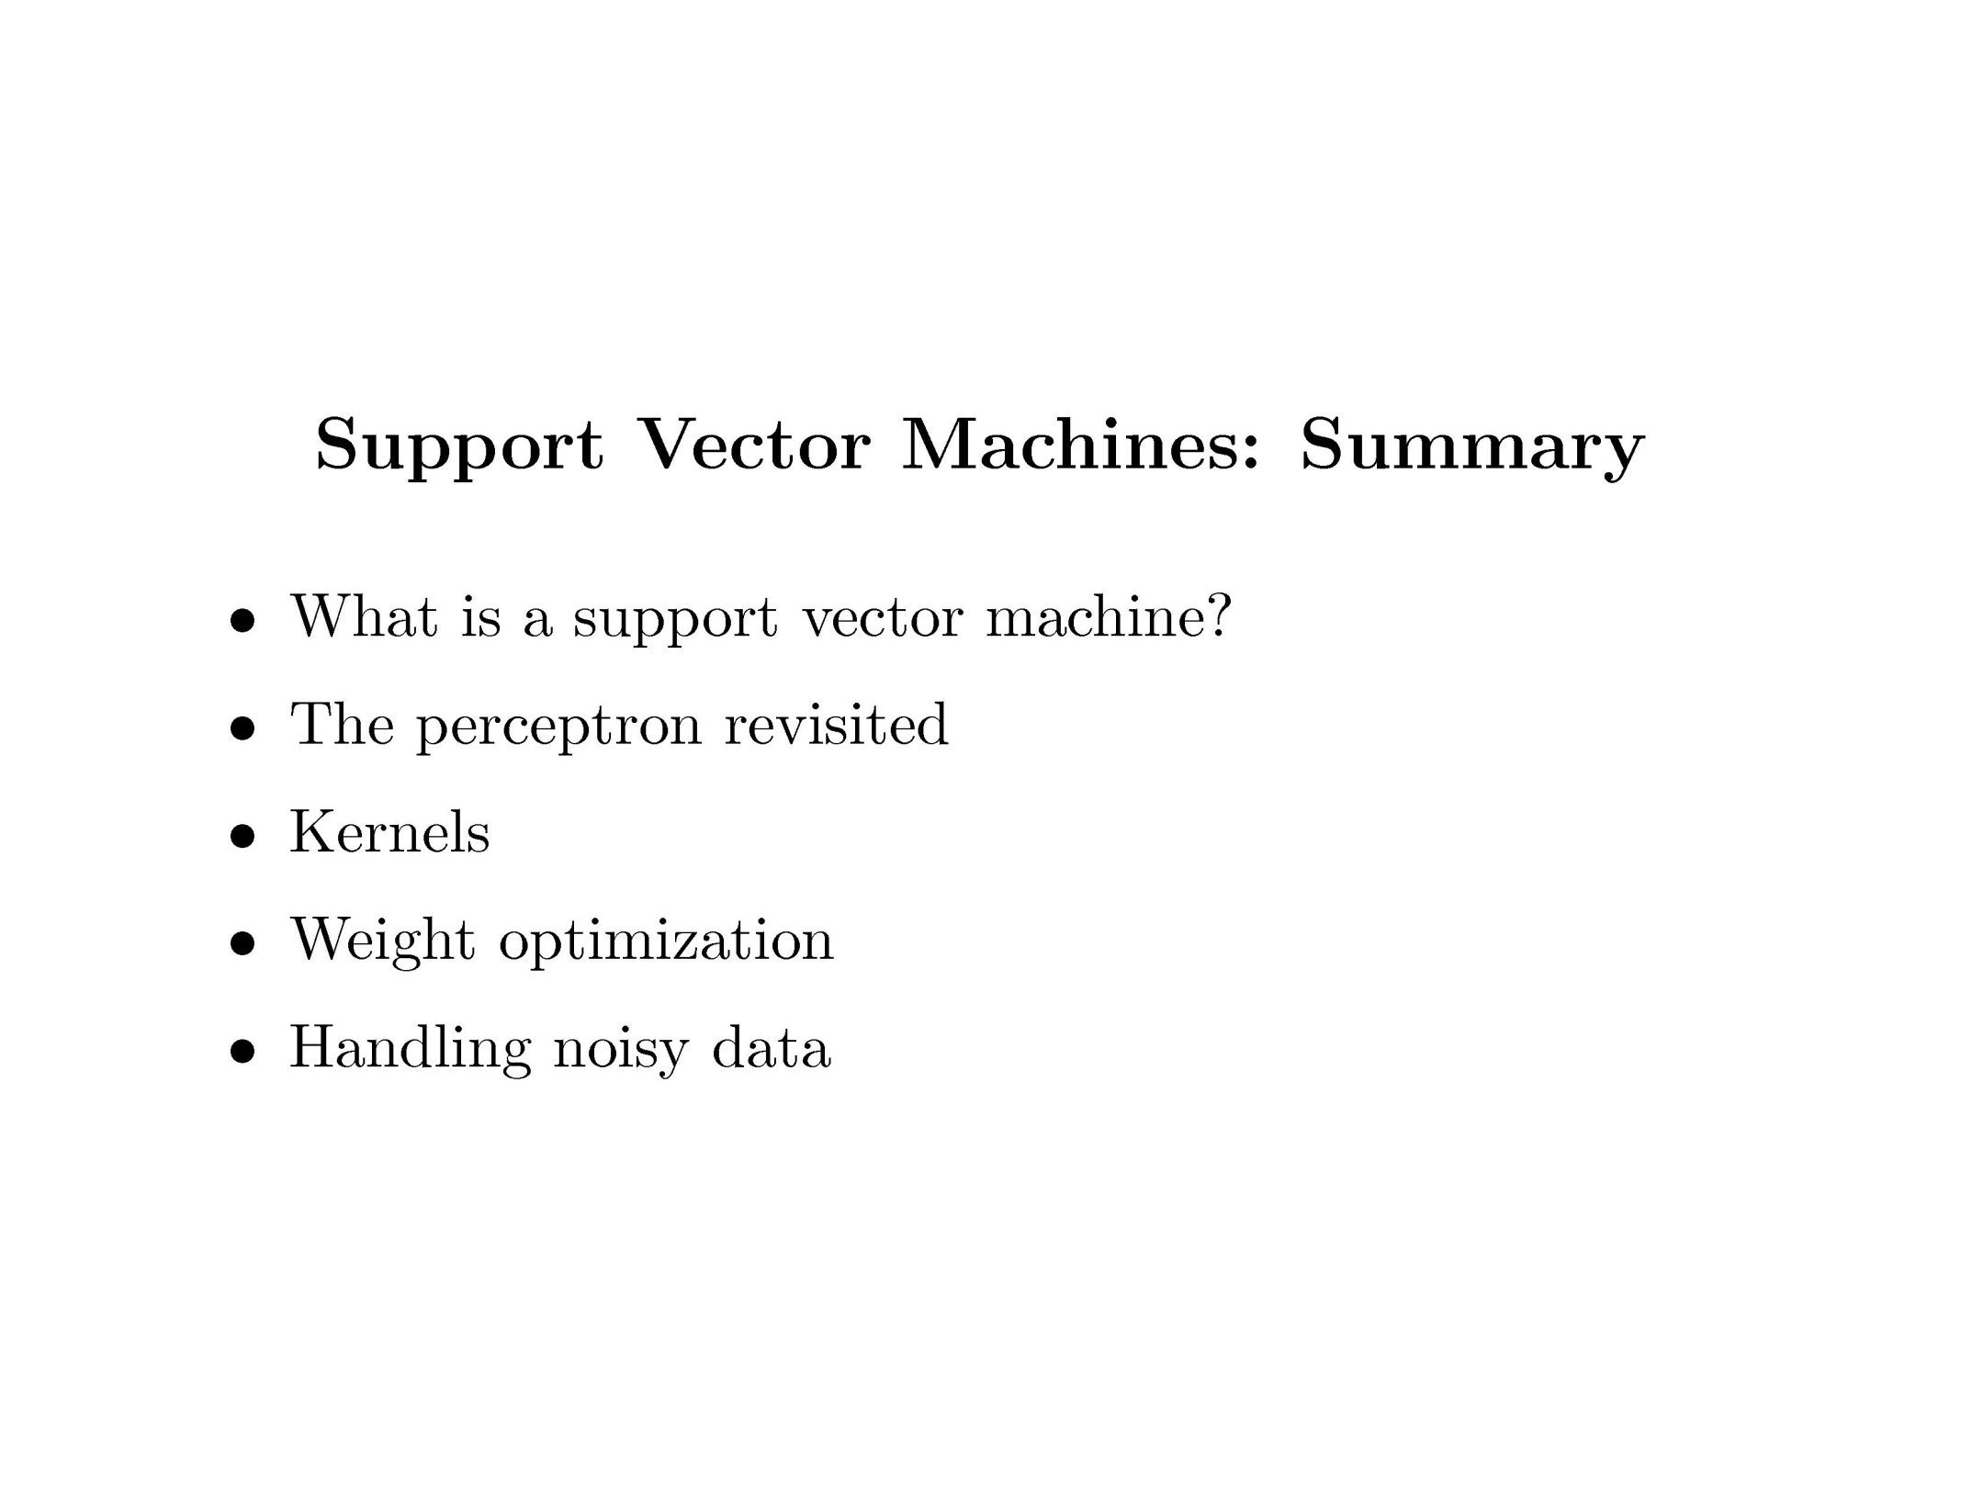
Support Vector Machine

Slide 21
Support Vector Machine
Exercise: Support Vector Machine

